Slide 1
Microelectronics and VLSI IT705D
Module 3: Microelectronics Process for VLSI Fabrication
(Part – II)

Slide 2
COMBINATIONAL LOGIC

Slide 3
Overview
Simple complementary MOS gates
Construction of complex CMOS gates
Stick diagrams

Slide 4
Combinational vs. Sequential Logic
Combinational
Sequential
Output =
(
)
Output =
(
)
f
In, Previous In
f
In

Slide 5
Static Complementary CMOS
Pull-up network (PUN) and pull-down network (PDN)
V_{DD}
PMOS transistors only
In₁
pull-up: make a connection from V_{DD} to F when F(In₁,In₂,…In_{N}) = 1
In₂
…
PUN
In_{N}
F(In₁,In₂,…In_{N})
In₁
pull-down: make a connection from F to GND when F(In₁,In₂,…In_{N}) = 0
In₂
…
PDN
In_{N}
NMOS transistors only
PUN and PDN are dual logic networks
Notes:
One and only one of the networks (PUN or PDN) is conducting in steady state (output node is always a low-impedance node in steady state)
Why PUN of PMOSs only and PDN of NMOSs only ? (Next slide)

Slide 6
NMOS Transistors in Series/Parallel Connection
Transistors can be thought as a switch controlled by its gate signal
NMOS switch closes when switch control input is high

Slide 7
PMOS Transistors in Series/Parallel Connection

Slide 8
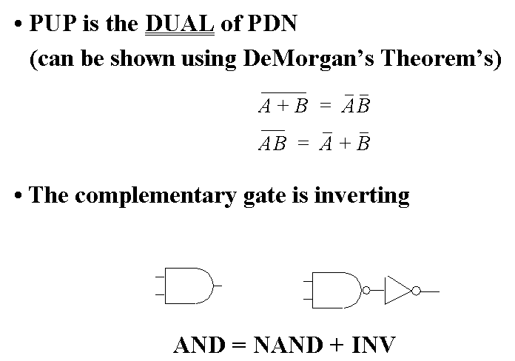
Complementary CMOS Logic Style

Slide 9
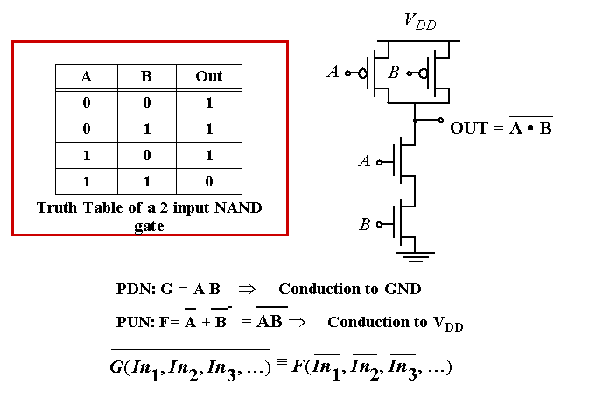
Example Gate: NAND

Slide 10
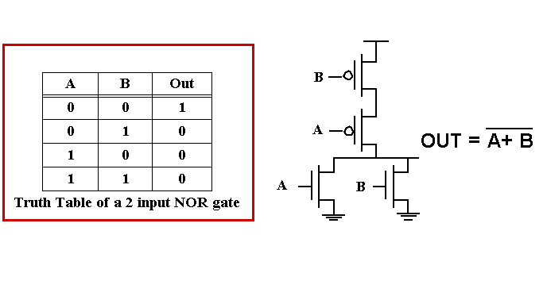
Example Gate: NOR

Slide 11
Complex CMOS Gate
B
A
C
D
OUT = D + A • (B + C)
A
D
B
C
Notes:
Shown synthesis of pull up from pull down structure

Slide 12
Constructing a Complex Gate

Slide 13
Stick Diagrams

Slide 14
Stick Diagrams
Objectives:
To know what is meant by stick diagram.
To understand the capabilities and limitations of stick diagram.
To learn how to draw stick diagrams for a given MOS circuit.
Outcome:
At the end of this module the students will be able draw the stick diagram for simple MOS circuits.

Slide 15
Stick Diagrams
Stick Diagrams
V_{DD}
V_{DD}
X
Stick
Diagram
X
X
X
Gnd
Gnd

Slide 16
Stick Diagrams
Stick Diagrams
V_{DD}
V_{DD}
X
X
X
X
Gnd
Gnd

Slide 17
Stick Diagrams
Stick Diagrams
VLSI design aims to translate circuit concepts onto silicon.
stick diagrams are a means of capturing topography and layer information using simple diagrams.
Stick diagrams convey layer information through colour codes (or monochrome encoding).
Acts as an interface between symbolic circuit and the actual layout.

Slide 18
Stick Diagrams
Stick Diagrams
Does show all components/vias.
It shows relative placement of components.
Goes one step closer to the layout
Helps plan the layout and routing
A stick diagram is a cartoon of a layout.

Slide 19
Stick Diagrams
Stick Diagrams
Does not show
Exact placement of components
Transistor sizes
Wire lengths, wire widths, tub boundaries.
Any other low level details such as parasitics..

Slide 20
Stick Diagrams – Notations
Stick Diagrams
Metal 1
poly
ndiff
pdiff
Can also draw
in shades of
gray/line style.
Similarly for contacts, via, tub etc..

Slide 21
Stick Diagrams – Some rules
Stick Diagrams
Rule 1.
When two or more ‘sticks’ of the same type cross or touch each other that represents electrical contact.

Slide 22
Stick Diagrams – Some rules
Stick Diagrams
Rule 2.
When two or more ‘sticks’ of different type cross or touch each other there is no electrical contact. (If electrical contact is needed we have to show the connection explicitly).

Slide 23
Stick Diagrams – Some rules
Stick Diagrams
Rule 3.
When a poly crosses diffusion it represents a transistor.
Note: If a contact is shown then it is not a transistor.

Slide 24
Stick Diagrams – Some rules
Stick Diagrams
Rule 4.
In CMOS a demarcation line is drawn to avoid touching of p-diff with n-diff. All pMOS must lie on one side of the line and all nMOS will have to be on the other side.

Slide 25
Function | PMOS | NMOS
AND (X . Y) | Parallel | Series
OR (X + Y) | Series | Parallel

Slide 26
How to draw Stick Diagrams
Stick Diagrams

Slide 27
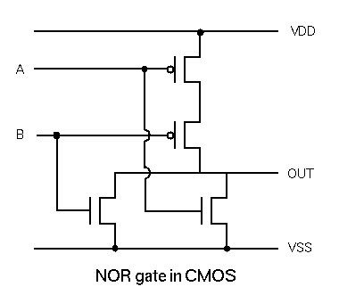
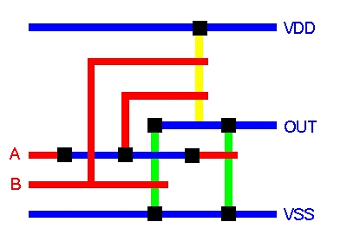
Stick Diagrams

Slide 28
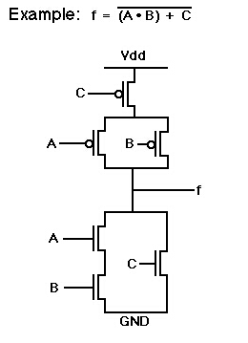
Draw This
Stick Diagrams

Slide 29
Stick Diagrams
Stick Diagrams
Summary:
What is stick diagram?
Why stick diagram?
Conventions and rules related to stick diagram.
Drawing stick diagrams.

Slide 30
Stick Diagrams
Assignment:
Draw the stick diagram for two input CMOS NAND gate.
Draw the stick diagram for two input NAND gate using NMOS Logic.
Draw the stick diagram for 2:1 MUX using a) Pass transistors b) Transmission gates.

